Slide 1

Predict iPhone Price
By Sandeep Jain

Slide 2
Mobiles phone come in all sorts of prices, features, specifications and all. Price estimation and prediction is an important part of consumer strategy. Deciding on the correct price of a product is very important for the market success of a product.

Slide 3

Code to Calculate Future iphone Price
data=read.csv("C:/admin.csv")
data
b=data$version #version
c=data$price #price
d=cor(b,c)
d
plot(b,c)
model=lm(c~b)
model
summary(model)
x=14 #model number
price=-22468+11450*(x)
print(price)

Slide 4




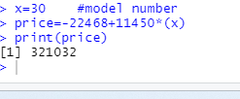
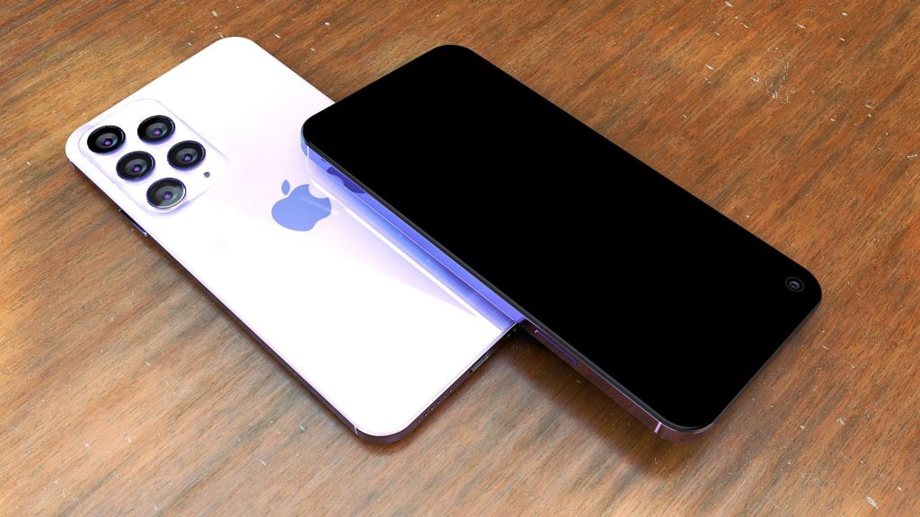
Predict iPhone 14 Price
Predict iPhone 15 Price
Predict iPhone 30 Price

